Slide 1
Market and Technology Research Summary
Project 50 - Non-intrusive Residential Power Disaggregation
Andrew Bailey*, Ralph Cullom, Manny Harris, Labib Kasim
ECE 484 Fall 2023

Slide 2
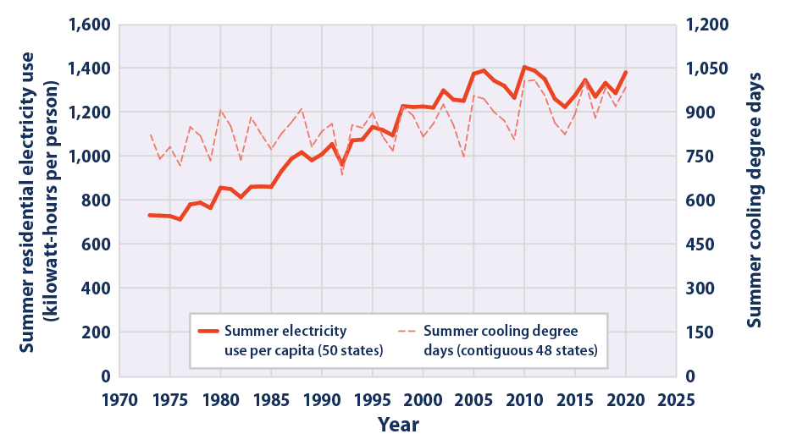
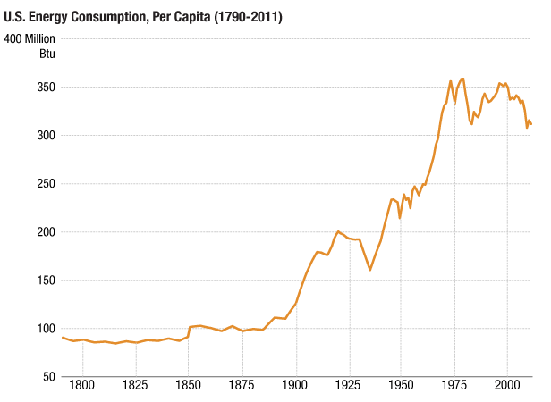
Consumer Base
Target Customers and Market Size
Our customers are homeowners
Potential 83.5 million customers in the U.S.
Any customer who desires to better comprehend their power usage
Brief Need Statements
Inform residents of their energy usage
Analyze power consumption over time
Send data to utility companies to analyze power consumption
Notes:
https://www.simplyinsurance.com/how-many-homeowners-in-the-us/
https://www.npr.org/sections/money/2013/04/10/176801719/two-centuries-of-energy-in-america-in-four-graphs

Slide 3
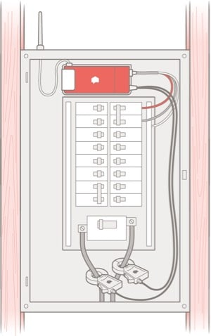
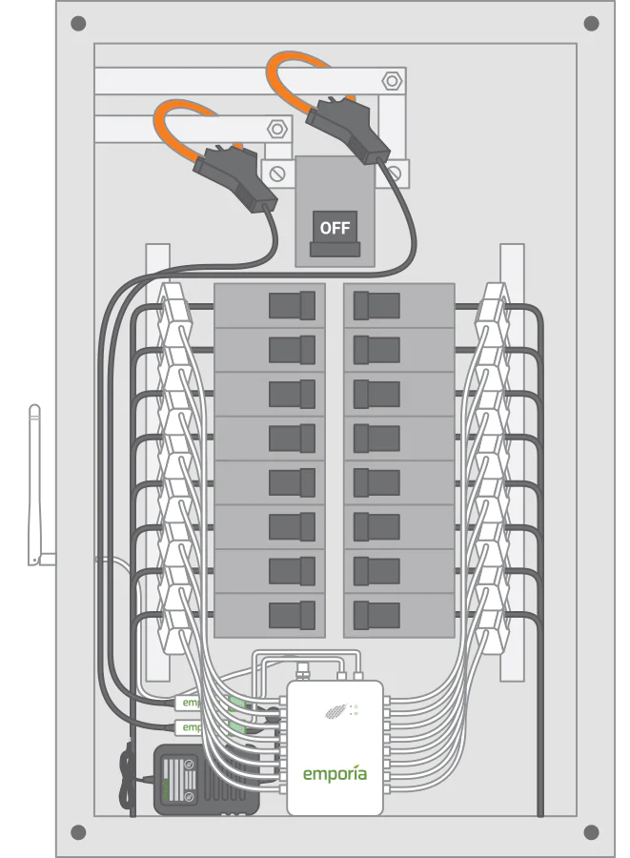
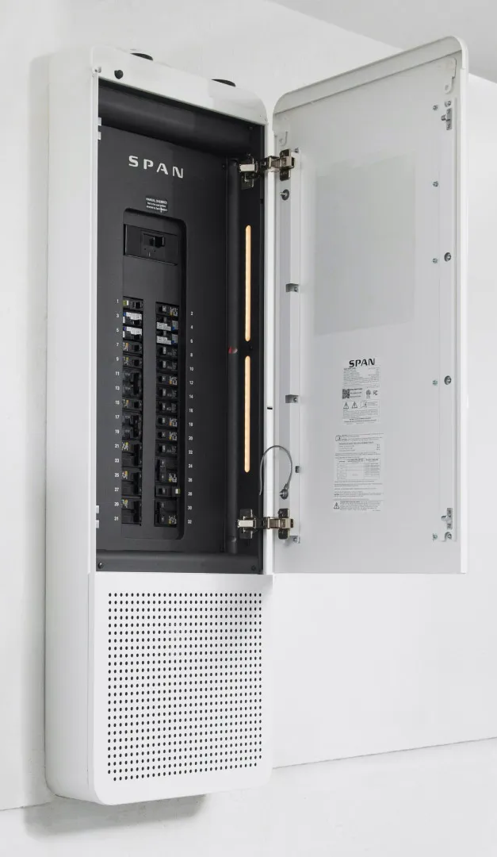
Market summary 2
Competitors
Sense
Emporia Vue
Eyedro HEM
SPAN
Value Proposition Statement
This product can save hundreds of dollars for residents by showing them where their energy is going. Our product can indicate where potential issues lie and can help the environment by analyzing energy use and showing where it may be wasted.

Slide 4
Technology Summary
Current technology
Sense, Emporia Vue, SPAN, and the Eyedro monitor examples of current technology
Sense is closely related to our product, measuring total power usage and displaying individual loads to the user
Advanced meter Infrastructures (AMI) are another method to disaggregate power but real-time disaggregated feedback is not possible with it.
Smart plugs are commonly used but they can only measure the output for a certain receptacle
Emerging Technologies
The integration of smart products in the home has the potential to be useful in analyzing residential power consumption through machine learning algorithms.
Applicable Standards:
National Electric Code - Wiring sizing for CT and power
American National Safety Institute - Safety standards
NEMA Standards - Enclosure for device

